Slide 1
Interrupt Service Routines
(ISRs)
Feb 28, 2026

Slide 2
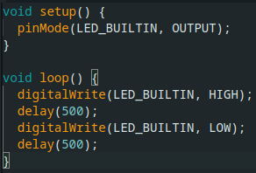
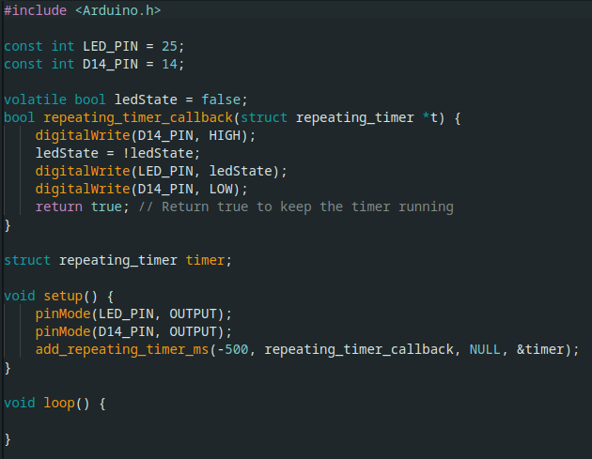
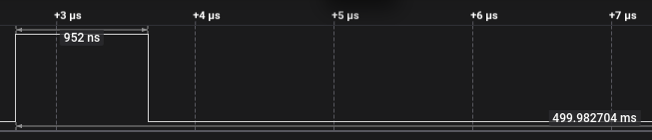
Simple Example of the Benefit of ISRs
100% CPU Utilization
~0% Utilization

Slide 3
How do ISRs Work?
Initialization
Interrupt Event
Main Loop
Interrupt Service Routine

Slide 4
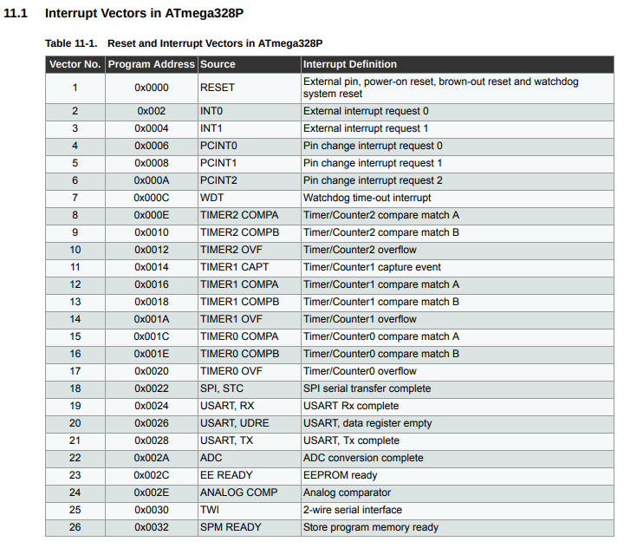
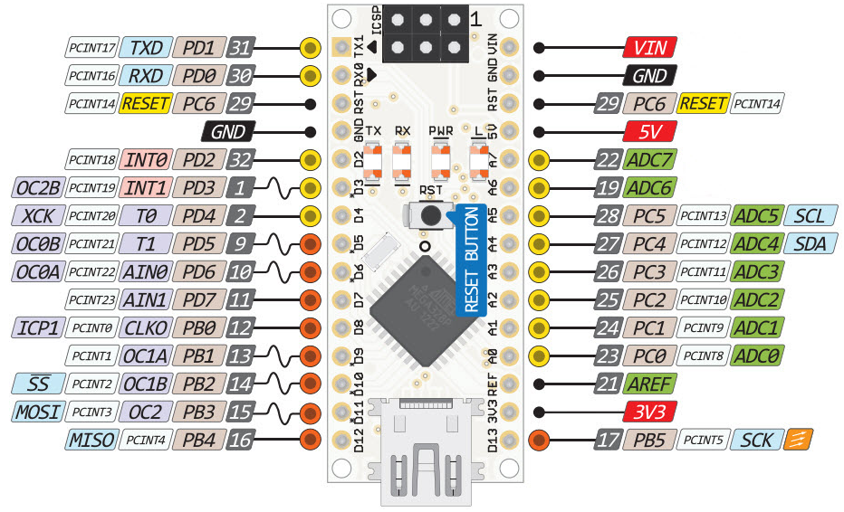
What Can Cause Interrupts?
Higher Priority

Slide 5
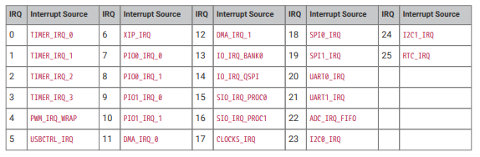
What Can Cause Interrupts?
RP2040 (Pi Pico)

Slide 6
ISRs Enable Event Driven Software
Can be a big “level-up” for hobbiests
- Code responds to events → “event driven”
- Response to events is very fast
- Loop can be less complex
- CPU utilization can be dramatically reduced
Initialization
Interrupt Event
Main Loop
Interrupt Service Routine

Slide 7
Event Driven Alarm Clock
...
Real Time Clock
Initialization
Snooze Button
Snooze Timer
Main Loop
Rotary Encoder Q
Rotary Encoder /Q
ISR: RTC
ISR: Snooze Button
ISR: Snooze Timer

Slide 8
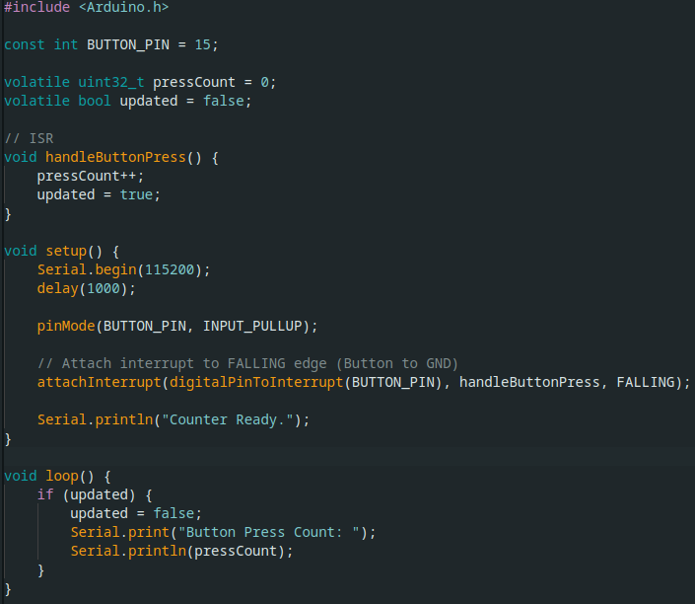
“Simple” Button Press Counter
Works great… except for switch bounce

Slide 9
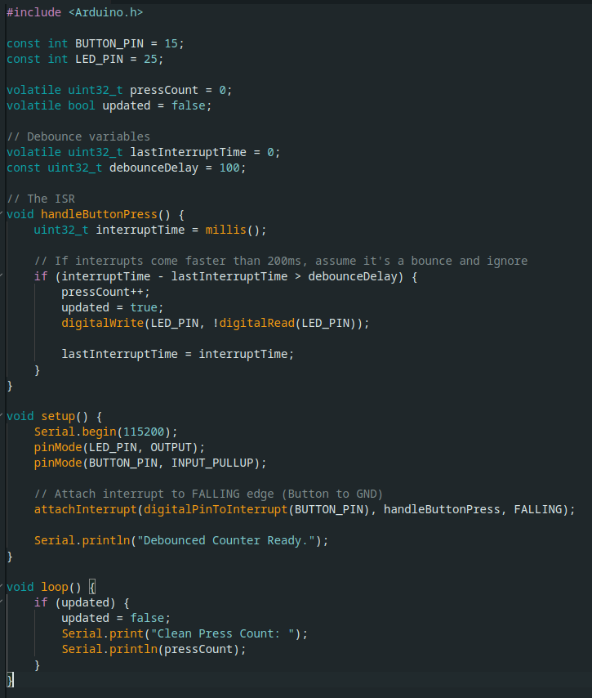
“Debounced” Button Press Counter
Works great… except it triggers on both btn press and release due to release bounce

Slide 10
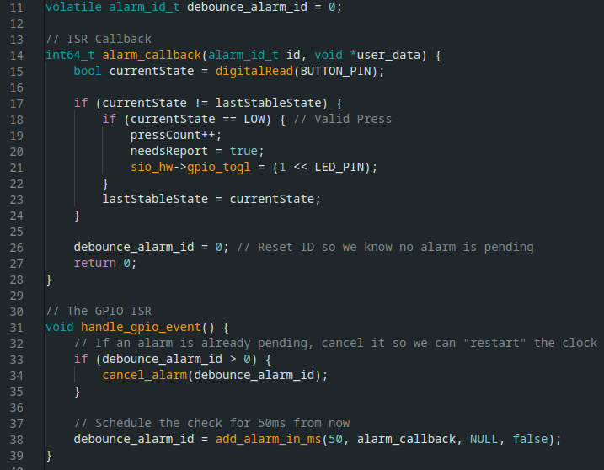
“Debounced” Button Press Counter With State Check
Works great!

Slide 11
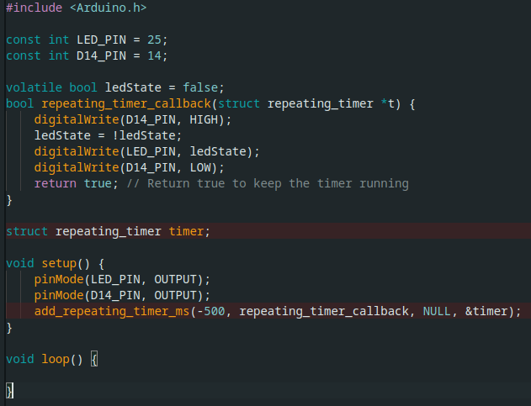
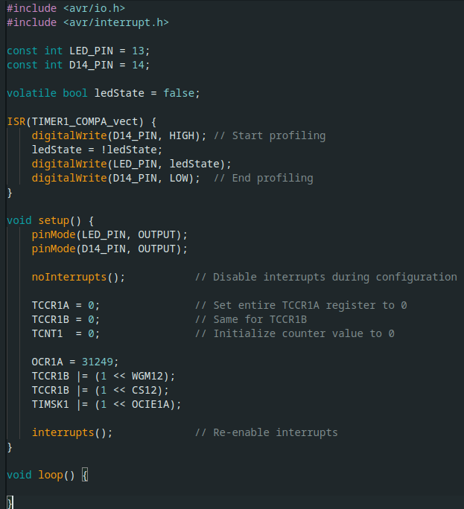
Interrupt Code is !(Always Portable)
This compiles for Pi Pico
But not for Arduino Nano
This compiles for Arduino Nano

Slide 12
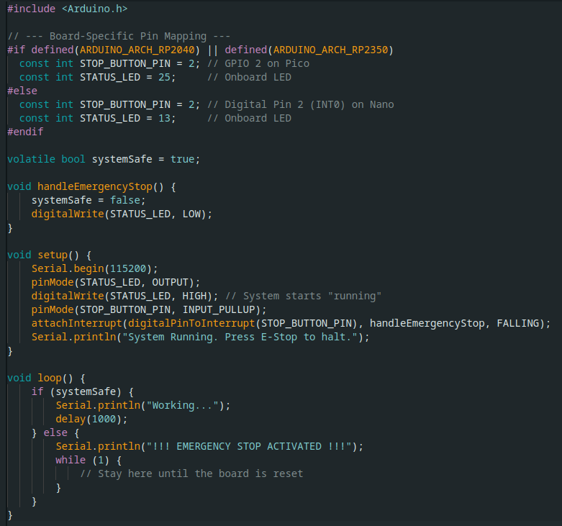
Pin Change Code May be Portable
This compiles for both
Pico and Nano

Slide 13
ATMEGA 328P Pin Change Notes
INTx are (usually) faster than PCINTx
Both take 4 cycles to jump to/from the ISR but PCINTx usually requires code to determine which pin changed
INTx can be used for wake-up

Slide 14
ISR Best Practices
1. Keep ISRs short
→ Consider setting a flag in the ISR and handling the rest in the main loop
→ Direct port masking, or other lower level hardware rather than Arduino built-ins
2. Don’t use delay() as it may need interrupts being used
3. Don’t use printf() because it is slow and uses interrupts
4. Use the volatile keyword when sharing a variable between your ISR and your loop

Slide 15
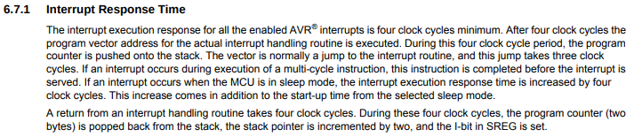
How Fast is an ISR?
1/16MHz = 62.5ns
4*62.5 + 4*62.5 = 500ns
PINB = (1 << 5); // This toggles PB5 (Digital Pin 13)
1 clock cycle
562.5ns minimum

Slide 16
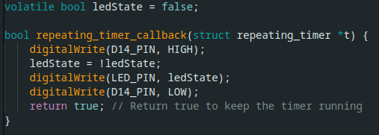
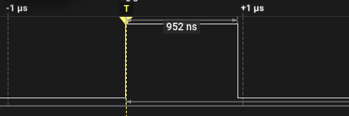
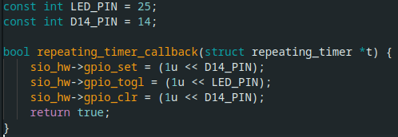
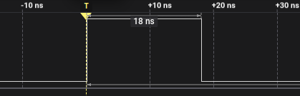
Tricks to speed up an ISR
Direct port masking is 50 times faster
150MHz → 6.667ns clock

Slide 17
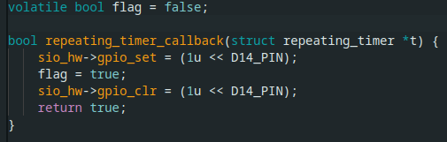
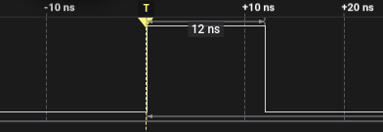
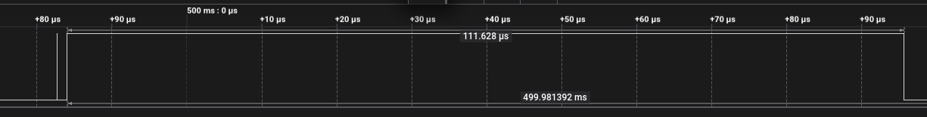
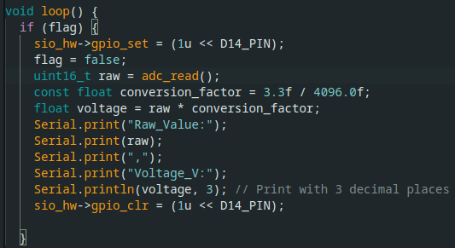
Tricks to speed up an ISR
Set a flag and then deal with it in loop()

Slide 18
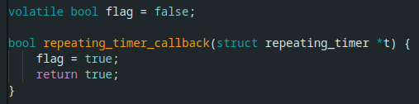
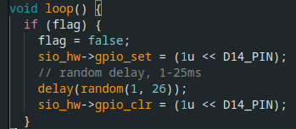
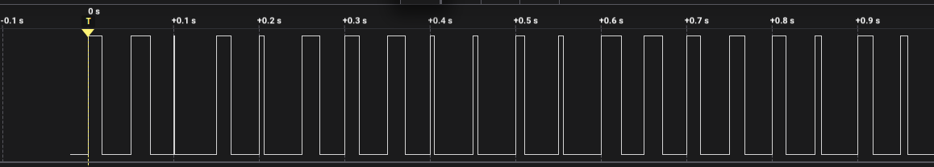
ISR provides precise timing

Slide 19
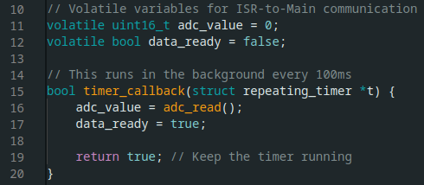
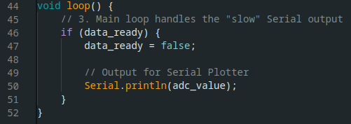
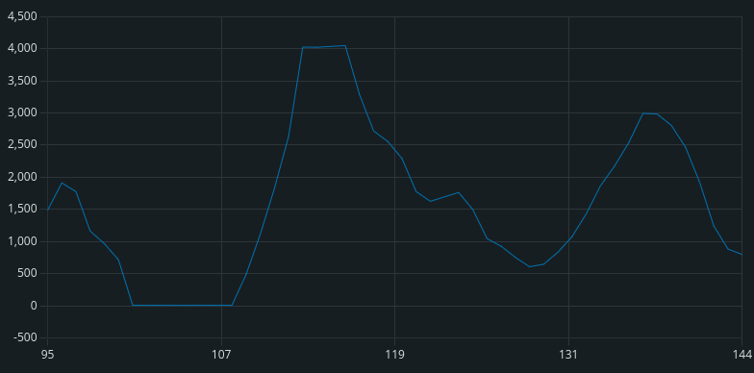
See ADC Example (100ms Sampling)

